Slide 1
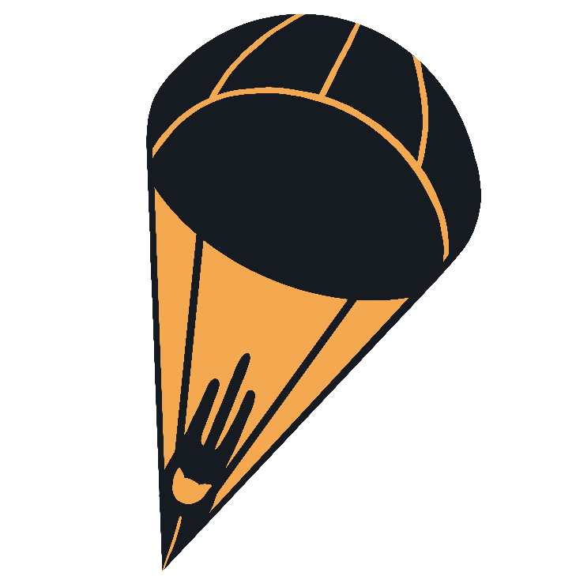
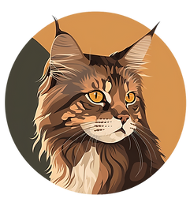
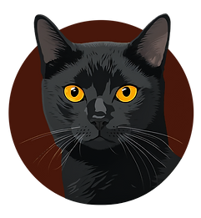
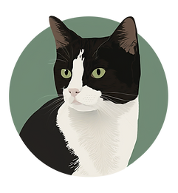
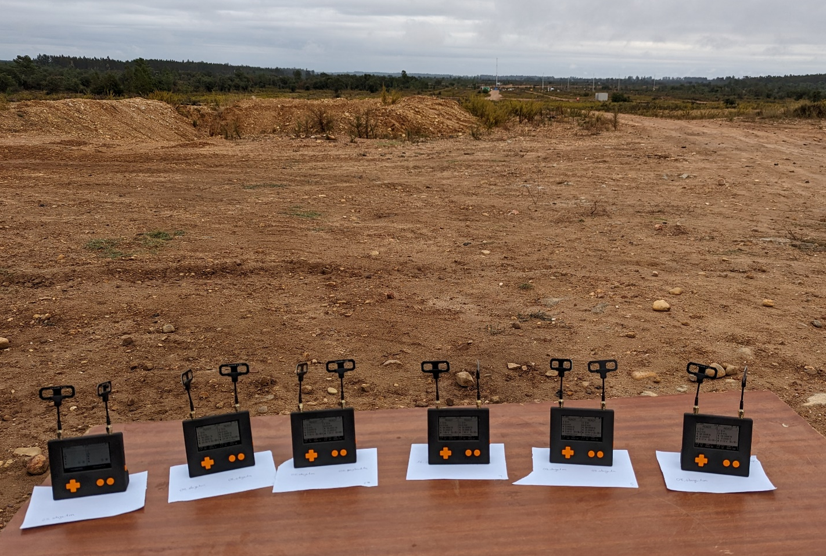
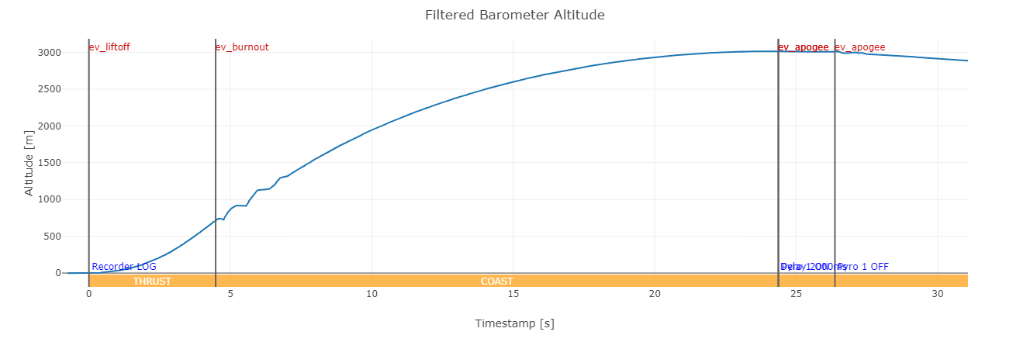
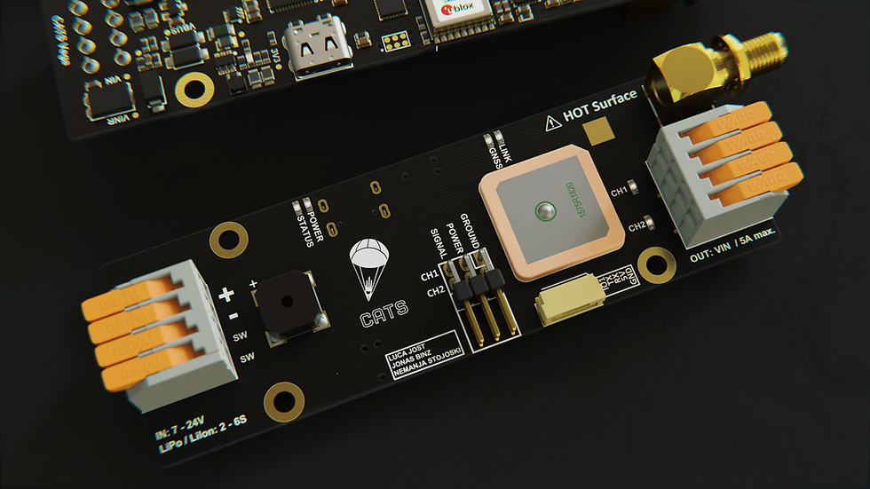
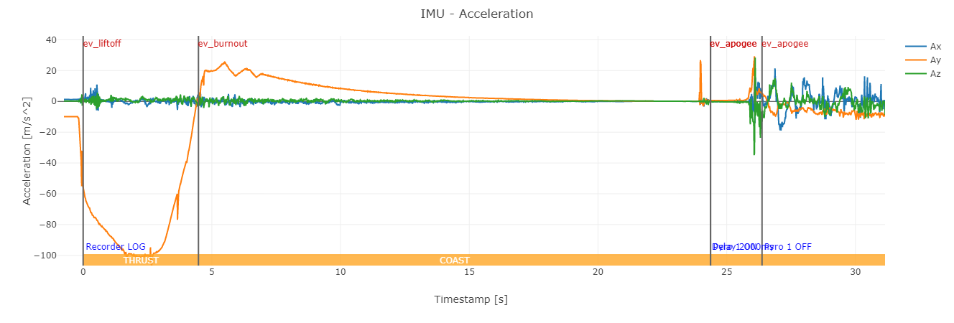
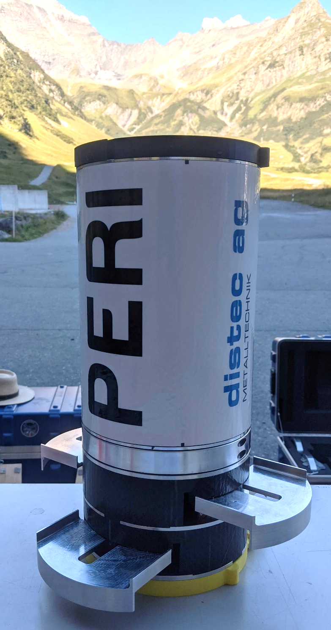
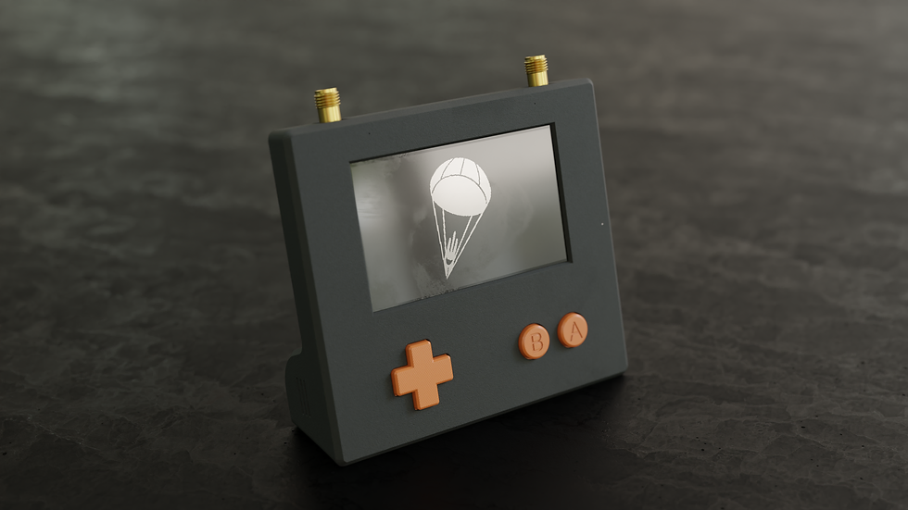


CATS: Flight Computers for Small-Scale Rockets
Who Are We?
Key Features
CATS began as a hobby project four years ago, with the goal of building a fully customizable open-source flight computer for model rockets going up to 30 kilometers. Since then, Vega has flown over 80 times in 30 different model rockets. Supplied to over 30 student teams, our flight computers have been selected as the official tracking and logging system for the European Rocketry Challenge (EuRoC) 2023 & 2024.
IMU, barometer & GNSS
Onboard flight logging (16 MB)
2x pyro channels
2x servo channels
General-purpose UART
Radio link tested up to 50 km
2.4 GHz with frequency hopping
Bidirectional communication, up to 1 W
Open-source software and hardware
Jonas Binz
Luca
Jost
Nemanja Stojoski
Official Tracking System for EuRoC
Software &
Control
Software &
Hardware
Software &
Data Handling
The European Rocketry
Challenge is an annual event
in Portugal where 25 student
teams from across Europe
compete. The teams are ranked
in different categories including
maximum reached altitude
and successful recovery. Every rocket launching at EuRoC is equipped with a Vega flight computer, ensuring uniform apogee reporting and tracking of the rocket. Teams also use mechanisms to reach target altitude with the help of airbrakes or other systems.
Vega Flight Computer
General-purpose flight computer
Auto-detecting orientation relative to ground
Flight phases implemented as a Finite State Machine (FSM)
Customizable events can be triggered at every FSM transition
Logging of all relevant flight data
Kalman filter fusing barometric and acceleration data for robust height and vertical velocity estimation
Dead reckoning orientation estimation
GNSS data update rate of 10 Hz
Custom antenna can be attached
Ground Station
Applications
Used to communicate with rocket(s) during flight
Can simultaneously receive data from two Vegas, or track one Vega with both receivers
Connection is established by configuring a “link phrase” that needs to match on both devices
A compass and GNSS module are
used to navigate to the rocket
Large transflective display
Flight logging
USB-C interface with data streaming
and battery charging
Tested with:
Supersonic rockets
Airbrake systems
Parachute line reefing
Two-stage recovery
Potential use for:
High altitude balloons
Two-stage model rockets
Custom recovery mechanisms
Active control
Payload management
…
www.smartdigi.ch
info@smartdigi.ch
catsystems.io
github.com/catsystems
info@catsystems.io

